Slide 1
Distracted Driver Detection
Team Details
Deepa Arul
Lenin Kumar Sv
Manjushree Kumar
Prasan Cumar
Rajesh Kanthan
Rajesh Parameswaran
Mentor
Dr. Sunil Kumar Vuppala

Slide 2
PROBLEM STATEMENT
Driver distraction is a significant and over-arching problem with many dimensions.
Distracted Driving involves any activity a person engages in, that has the potential to distract him or her from the primary task of driving and increase the risk of a crash.
It is clear that the problem of distracted driving is not likely to go away with the ever-expanding opportunities for staying in touch while driving.
The need to address this issue and implement effective countermeasures is urgent to improve public safety.

Slide 3
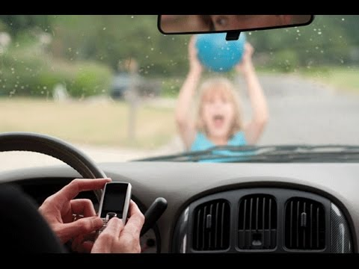
WHY IT IS IMPORTANT?
1.2 million people die in road crashes worldwide each year.
80 to 90 percent of road crashes is caused by driver behavior.
Distracted drivers are about 4 times as likely to be involved in crashes as those who are focused on driving.
By 2030, road traffic injuries are projected to be the fifth leading cause of death worldwide.
518 billion US dollars is estimated to be the cost of crashes in the world.

Slide 4
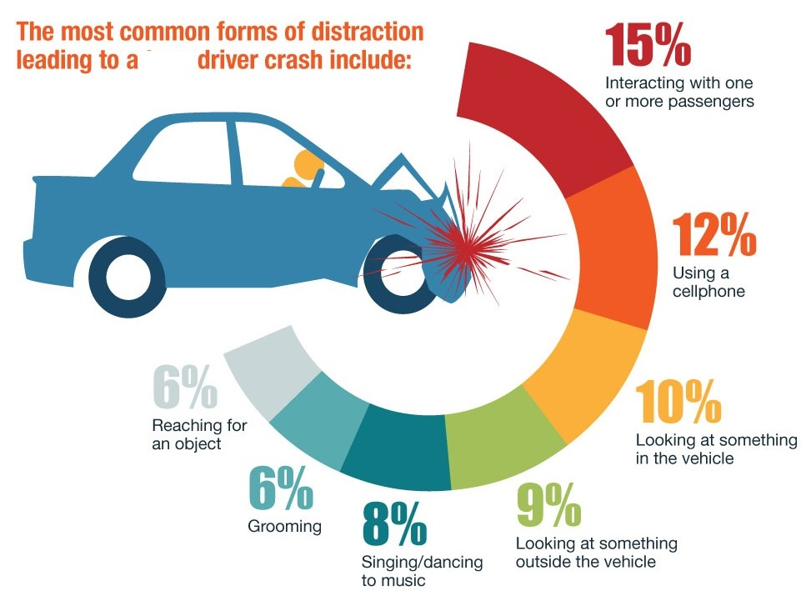
Value Addition
Can be used On detecting a distracted action, process to alert the driver / anyone can be initiated.
by transport companies to assess quality of their drivers.
Same model can be used across countries to help in larger activities like traffic surveying.
Helping insurers understand more about the risks they're covering.
Encouraging better driving habits and improving road safety.

Slide 5
Suggested Solution
By leveraging deep learning techniques
To develop an accurate and robust system for detecting distracted driver and warn them against it.
To classify the cause of distraction which will help initiate appropriate follow up actions.
To use convolution neural networks and machine learning models to predict the probability for each class.
To select the best model maintaining good accuracy which is desirable in real time applications

Slide 6
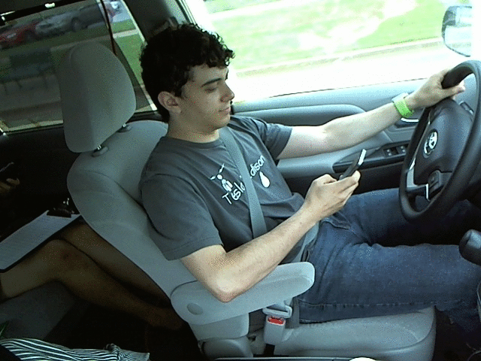
Dataset Details
State Farm – Kaggle challenge dataset.
The training images had corresponding labels attached. Labels belonged to one of the ten classes as mentioned below:
c0: normal driving
c1: texting – right
c2: talking on the phone – right
c3: texting - left
c4: talking on the phone - left
c5: operating the radio
c6: drinking
c7: reaching behind
c8: hair and makeup
c9: talking to passenger

Slide 7
Data Exploration
Train (labeled) and Test image dataset prepared and made available by State Farm Insurance Company
2D color images taken from dashboard camera with pixel resolution are 640 x 480, Train data arranged in folders as per their corresponding classes (10 classes)
Train & Test contains 22,400 and 79,727 images respectively
Train data details :
Image count across the classes are similar (2300 images)
26 different drivers likely of ethnicity African(1), Asians(10), Americans/Europeans (15)
14 Male, 12 Female drivers and their images are repeated in each class and contains duplicates also
Drivers wears glasses/coolers (11) , full sleeve(11), Half sleeved(15)
Proportion of images of these drivers randomly varies in each class
Test Data Details
Images taken with large number of drivers different from the Train data set

Slide 8
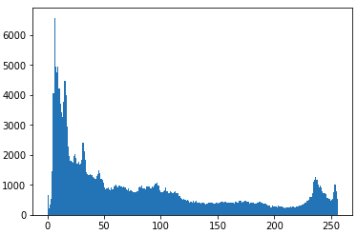
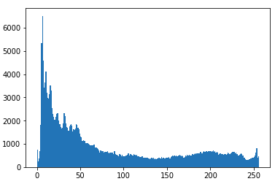
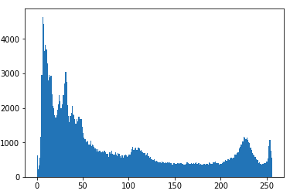
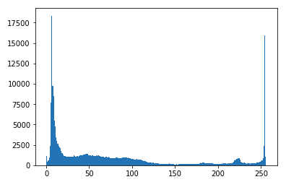
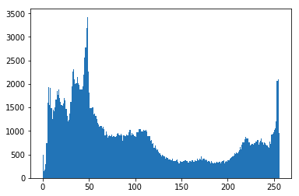
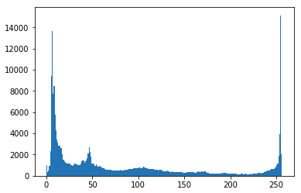
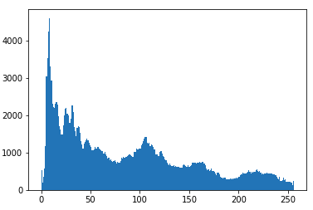
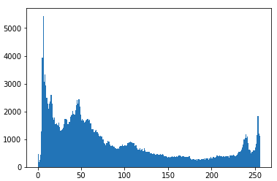
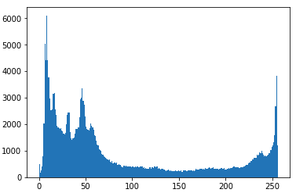
Data Exploration
Pixel Intensity (Gray Scale Images)
C0 : Safe Drivers
C1 : Texting right
C2 : Talking on Phone right
C3 : Texting Left
C4 : Talking on Phone Left
C5 : Operating Radio
C6 : Drinking
C7 : Reaching Behind
C8 : Hair Makeup
C9 : Talking to Passenger
X Axis: Pixel Value

Slide 9
Data Pre-processing
Purpose:
To expose the network to a wider variety of image characteristics like luminous , color channels
To make algorithm learn and remain invariant to transformations of the images
To correcting the deficiencies that may damage the learning process, such as omissions, noise and outliers
To simplify and optimize the training of the learning model
To reduce Dimensions of input images, maintain the uniform size and aspect ratio of input images
Benefits:
Increases the performance of CNN layers
Improves the learning rate and accuracy
Improves generalization
Decreases the sensitivity of the training to noise and over fitting

Slide 10
Data Pre-processing
Methods Exprerimented:
Normalization – Restructuring images to same scale
Augmentation (mirroring, rotation, scaling, and Color modifications)
Intensity Inversion, Intensity Quantization, Soft Threshold
Methods implemented:
Resize
Normalize
Convert to gray scale (Custom Model)

Slide 11
Tensorflow vs Theano
Advantages of Tensorflow
Has a faster compile time than Theano
Offers data and model parallelism
It can be deployed on multiple CPUs and GPUs
Supported by Google
Can run even on smartphones
Disadvantages of Theano
It can be troublesome on AWS
Large models can demand long compile times
Error messages doesn’t help much in debugging
Can’t be deployed on multiple GPUs
Tensorflow version – 1.9.0

Slide 12
Why Keras, not just Tensorflow ?
Keras is a layer on top of Tensorflow and Theano to make design and experiments with Neural Networks easier and provide a common interface.
Tensorflow and Theano are low level implementations of the algorithms and a low level API.
Keras provides all the general purpose functionalities for building Deep learning models, which is developer friendly.
TensorFlow is used primarily in case of research or developing some special kind of deep learning models.
Keras version – 2.2.2

Slide 13
Approach – 1
Custom model was created by taking an initial reference from one of pre-trained models.
An approach similar to GridSearch was used to create multiple models using combinations of Convolution and Dense layers.
Grey scale conversion of images helped improve performance drastically, enabling to train with larger samples.
Introducing Batch Normalization, helped arrive at better accuracy for each run.
Initially the channels used was very low. Increasing the number of channels helped improve accuracy.
Increasing depth of dense layers led to low learning rate and training was time consuming.

Slide 14
Approach – 1 – Parameters
Model | No. of Samples | Batch Size | No. Of Epochs | Optimizer | Results
Model -1 Filter_Size – 3 to 4 | 3000 | 32 | 25 | SGD | Accuracy Score Train – 12.03 Test – 17.53 | Loss Train – 89.67 Test – 75.76
Model – 2 Filter_Size – 3 to 15 | 3000 | 32 | 25 | SGD | Accuracy Score Train – 0.3100 Test - 0.3377 | Loss Train - 2.0878 Test - 2.0914
Model – 3 Filter_Size – 32 to 256 | 3000 | 32 | 55 | SGD | Accuracy Score Train – 1.000 Test - 0.9422 | Loss Train - 0.0011 Test - 0.1651
Model - 4 Filter_Size – 96 to 768 Dense Size – 4500 to 10 | 20000 | 100 | 30 | adam | Accuracy Score Train – 0.9929 Test - 0.9787 | Loss Train – 0.0371 Test – 0.1531
Model - 5 Filter_Size – 96 to 768 Dense Size – 16000 to 10 | 20000 | 100 | 30 | adam | Accuracy Score Train – 0.9743 Test - 0.9432 | Loss Train – 0.0256 Test - 0.1149

Slide 15
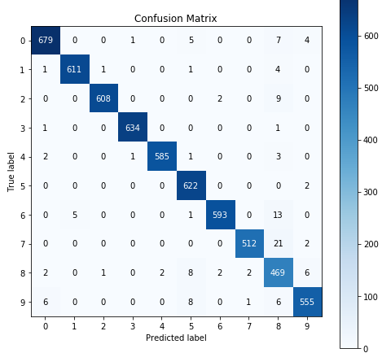
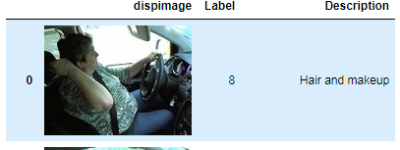
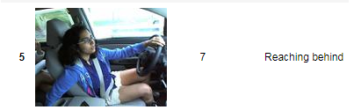
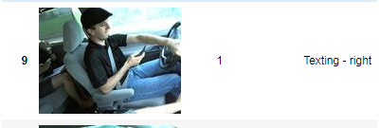
Approach – 1 – Confusion Matrix, Model-4

Slide 16
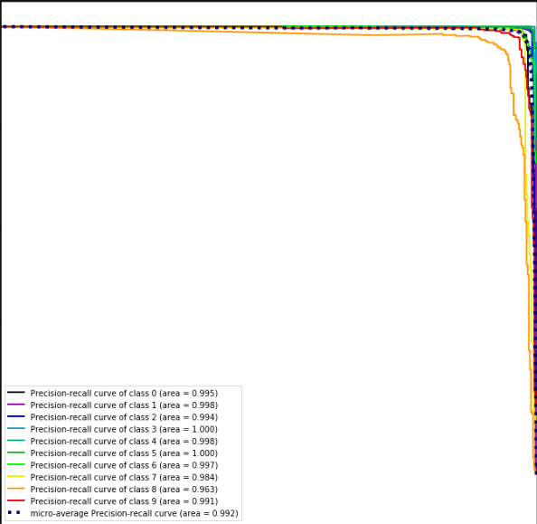
Approach – 1 – PrecisionRecall , Model-4

Slide 17
Approach – 2
Few models pre-trained on “imagenet” dataset were used to train with sample from distracted drivers dataset.
VGG - 3X3 convolution layers stacked on top of each other in increasing depths.
It is very slow to train.
The network architecture weights themselves are quite large in bandwidth
ResNet50 - subtraction of feature learned from input of that layer using shortcut connections.
The best accuracy and prediction was obtained.
The model training was faster in comparison to VGG.
MobileNet - for embedded based vision applications where there is lack of compute power.
For our set of images, the accuracy was average using this model.
AlexNet - less number of convolution and fully connected layers.
Seemed to train the fastest.
However, the test accuracy was bit jittery for different runs.

Slide 18
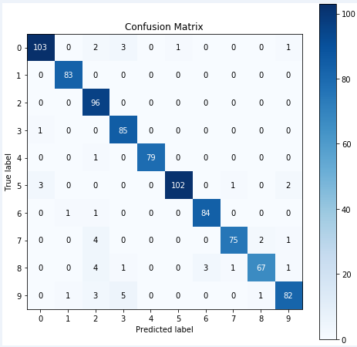
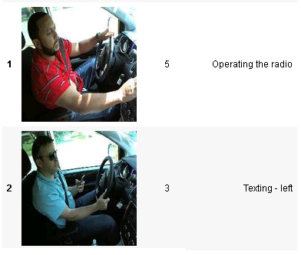
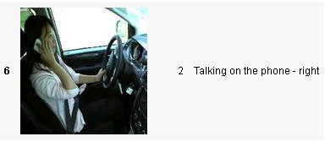
Approach – 2 – Confusion matrix

Slide 19
Approach – 2 – Parameters
Model | No. of Samples | Batch Size | No. Of Epochs | Optimizer | Results
VGG16 | 3000 | 32 | 25 | SGD | Accuracy Score Train – 1.000 Test - 0.9622 | Loss Train - 0.0011 Test - 0.1651
VGG19 | 3000 | 32 | 25 | SGD | Accuracy Score Train – 0.3100 Test - 0.3377 | Loss Train - 2.0878 Test - 2.0914
ResNet50 | 3000 | 32 | 50 | adam | Accuracy Score Train – 1.0000 Test - 0.9677 | Loss Train - 5.0345e-05 Test - 0.1149
MobileNet | 3000 | 32 | 50 | adam | Accuracy Score Train – 0.6214 Test - 0.5822 | Loss Train - 0.8248 Test - 1.0023
AlexNet | 3000 | 32 | 50 | adam | Accuracy Score Train – 0.9833 Test - 0.8922 | Loss Train - 0.0596 Test - 0.4927

Slide 20
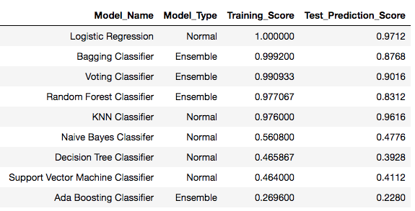
Approach – 3
Couple of distinctive methods investigated
Method – 1: By directly feeding images in the form arrays, without using CNN layers.
Sample of 5000 images were used in ratio of 70:30 for train and test.
Below are the results obtained using machine learning models & ensembling techniques

Slide 21
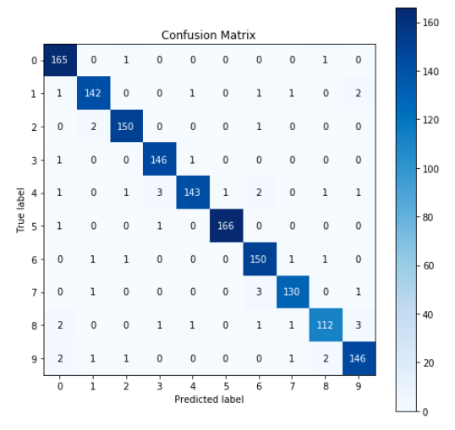
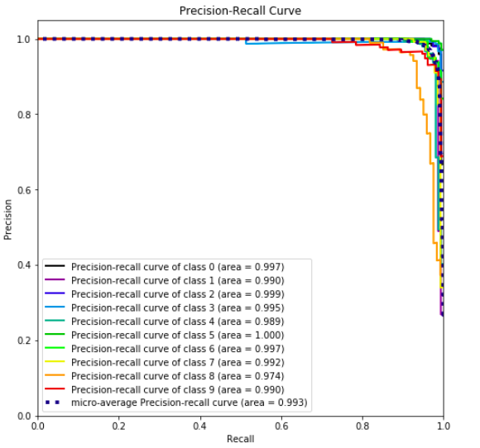
Approach 3 - Logistic Regression

Slide 22
Approach 3 – Hybrid Model
Method – 2:
- CNN works as a trainable feature extractor and SVM performs as a recognizer. SVM is used as an alternative to softmax (at output layer) which enhances generalization
- The original CNN is trained with several epochs until the training process converges and SVM replaces the output - layer and gets trained
- Trained SVM then performs the classification of test images
Approach was applied and tested on VGG16 Pre-trained model
Advantages
CNN classifier automatically extracts the salient features of the input image and are invariant in a certain degree to the shift and shape distortions
Model | No. of Samples | Batch Size | No. Of Epochs | SVM* | Results
Hybrid | 1000 | 32 | 25 | Kernel – Poly Gamma – 0.5 C – 0.025 | Accuracy Score Train – 73% Test – 68%
*Parameters arrived through Grid Search

Slide 23
Best solution
Custom Model
Convolution Layer -2:
Dense Layer- 2:
Amalgamations of convolution, max_Pooling and dense layers were experimented and the above combination was finalized.

Slide 24
Best solution
Test Accuracy – 97%
Parameter | Value
Total no of Images | 20,000
Train : Test ratio | 14000 : 6000 images (70 : 30)
Train : Validation ratio | 11200 : 2800 images (80 : 20)
Batch size , No. of epochs | 100, 30
Optimizer | adam
Loss | categorical cross entrophy
Drop out % | 0.1 (Both CNN and Denser Layers

Slide 25
Visualization
Keras-Vis for visualizing and debugging trained keras net model
Activation maximization : outputs small values for large filter activations
Saliency map : compute gradient of output category with respect to input image
Class activation map : discriminative image regions used by the CNN to identify that category
Used Activation maximization on Custom Model to identify the pattern
Features the deep learning model learn
Eliminate low level and dead features
Facilitate people to design and train better deep learning models
Make deep learning models more understandable and accessible to people

Slide 26
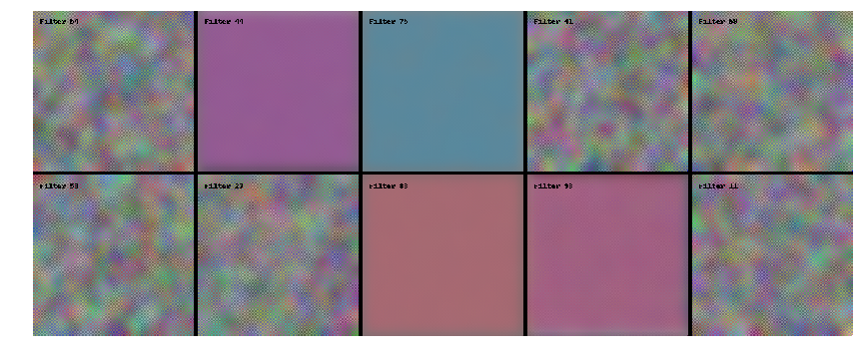
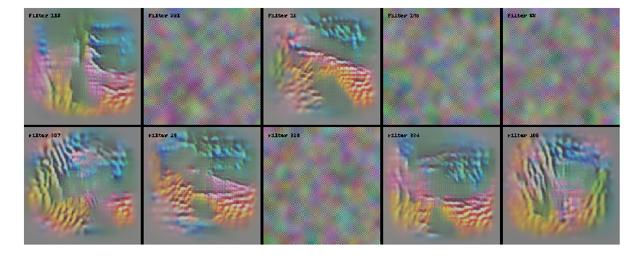
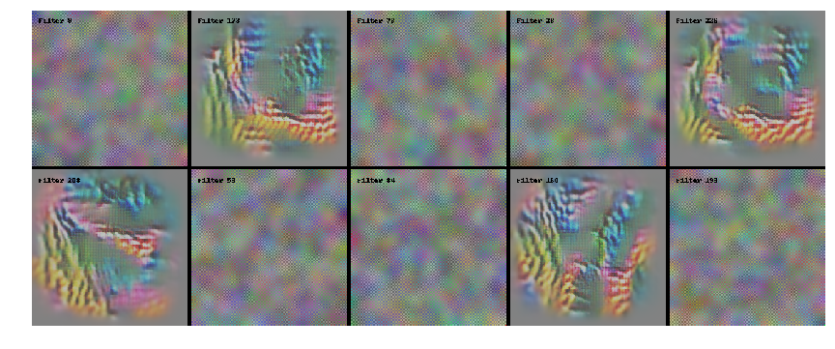
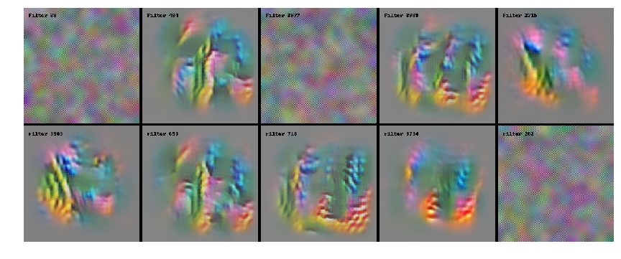
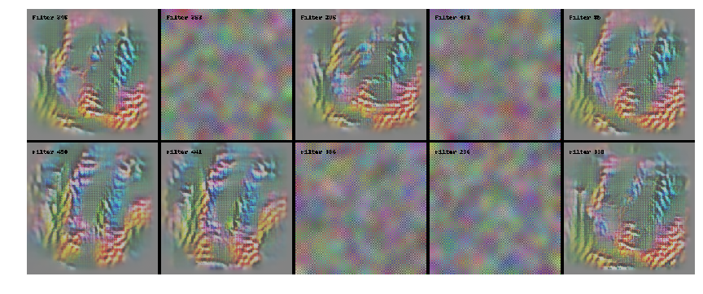
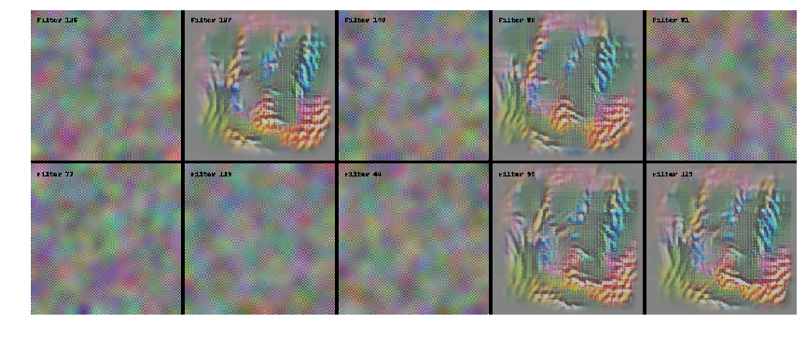
Visualization Cont…
conv2d_1 : few of the 96 filters
conv2d_4 : few of the 384 filters
conv2d_5 : few of the 768 filters
Layer 1 Activations - dense_1
Layer 1 Activations - dense_6
Layer 1 Activations – dense8

Slide 27
Challenges and Improvements
Challenges
Used CPU systems for this project.
Better computing resources, would have helped improve results.
L2 regularization and ensemble techniques could not be adequately implemented.
Overfit during training was easy, since small sample was used.
High similarities between images with the same driver, caused the training model to over-emphasize on the drivers’ features instead of their driving behaviors.
Possible improvements Future Works
Better face and hands detector to train a Fast RCNN to localize both in one shot
To use the predictions for follow up actions based on number of distractions in each class
Training the model with diverse range of images from various countries.

Slide 28
Thanks!

